Slide 1
Olist Product Customer Satisfaction
Team 3: Prachi Khanna & Se’Lina Lasher

Slide 2
Customer Satisfaction Prediction
Dataset: Kaggle’s Brazilian E-Commerce Public Dataset by Olist
Contains information on 100k ecommerce orders from the Olist Store in Brazil, covering the years 2016 to 2018.
Includes various aspects such as order status, price, payment and freight details, customer location, product attributes, and customer reviews.
Data has been anonymized with references to companies replaced by Game of Thrones house names, and includes a geolocation dataset linking Brazilian zip codes to latitude/longitude coordinates.
Goal: Our goal is to leverage this dataset to accurately predict customer satisfaction for our products. By understanding and anticipating customer satisfaction, we aim to improve product quality, enhance customer experiences, and drive increased sales and loyalty.
Notes:
Se’Lina

Slide 3








General System Services
Amazon S3
Model
Sage Maker Studio Lab
Sage Maker Registry
Sage Maker Feature Store
Sage Maker Ground Truth
Sage Maker End Point
Amazon Cloudwatch
Sage Maker Data Capture
Cloudwatch Alarm
Notes:
Prachi S3 to store and retrive data, models, predictions, datacapture, baseline etc. Sagemaker for design, train and deploying models and monitors, cloudwatch for monitors and alarms

Slide 4
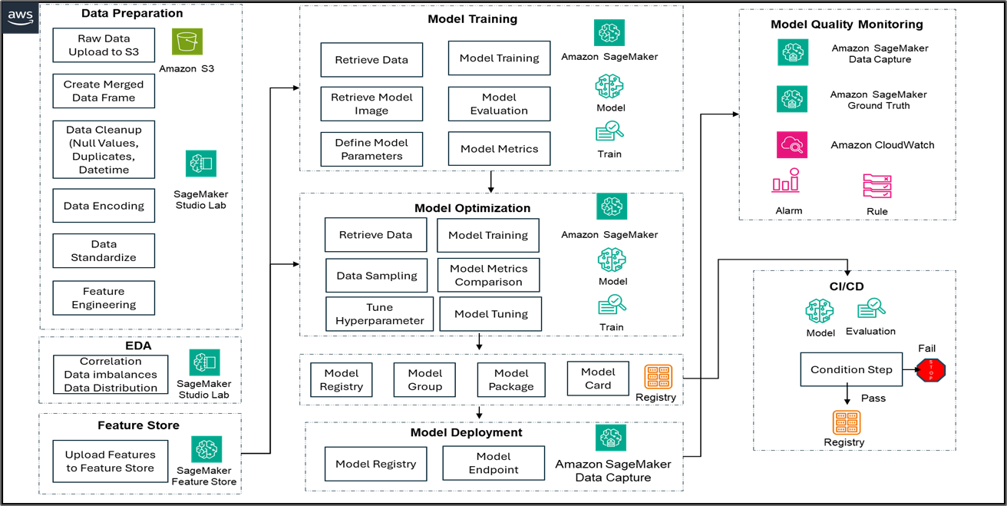
System Architecture
Notes:
Prachi – AWS cloud based services. This depicts the end to end flow of the project

Slide 5
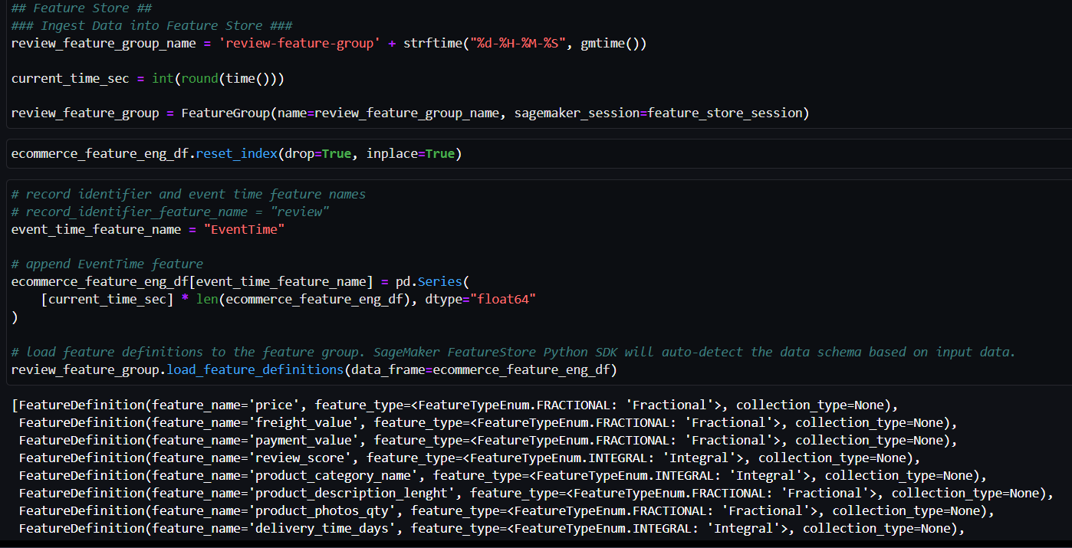
Feature Store
Raw Data: 9 CSVs (customer, order, payment, product, geolocation, etc.)
EDA: Identified important features; dropped unrelated columns
Feature Engineering: Converted datetime features to days
Feature Store: Uploaded for reusability
Notes:
Prachi

Slide 6
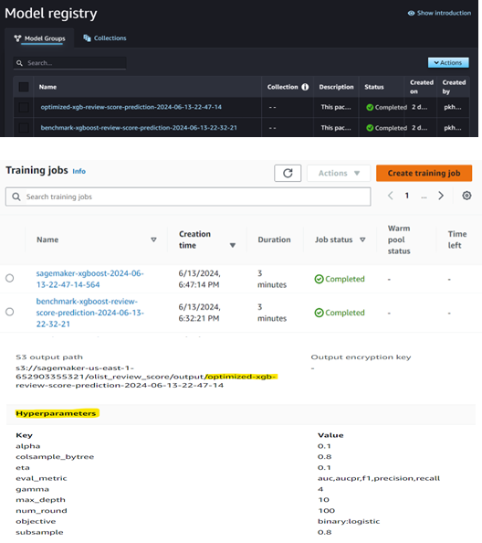
Binary Classification with XGBosot
Baseline Model: max depth 5, learning rate 0.2, gamma 4, subsample 0.8, colsample_bytree 0.8, alpha 0.1, 100 boosting rounds
Optimized Model: increased max depth to 10, reduced learning rate to 0.1
Evaluation: predictions on batch dataset, binary threshold 0.8
Performance: accuracy 0.6885, precision 0.8654, recall 0.7057, F1 score 0.7774, ROC AUC 0.6682
Conclusion: Optimized model outperforms baseline, justifying deployment
Notes:
Prachi

Slide 7
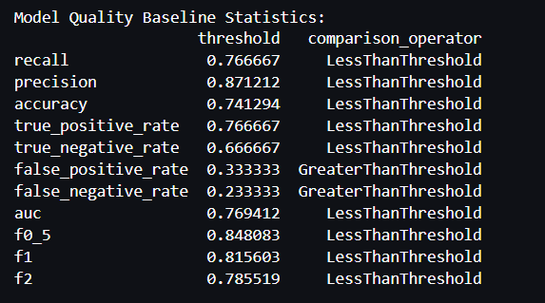
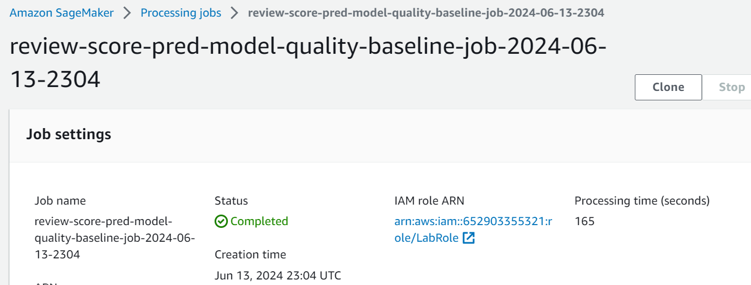
Model Quality Monitor (Baseline)
Baseline Job: Computes performance data and suggests quality constraints
Baseline Dataset: Uses optimized model output (predictions and ground truth labels)
Baseline Statistics: Provides metrics and suggests constraints for monitoring quality drift
Notes:
Prachi

Slide 8
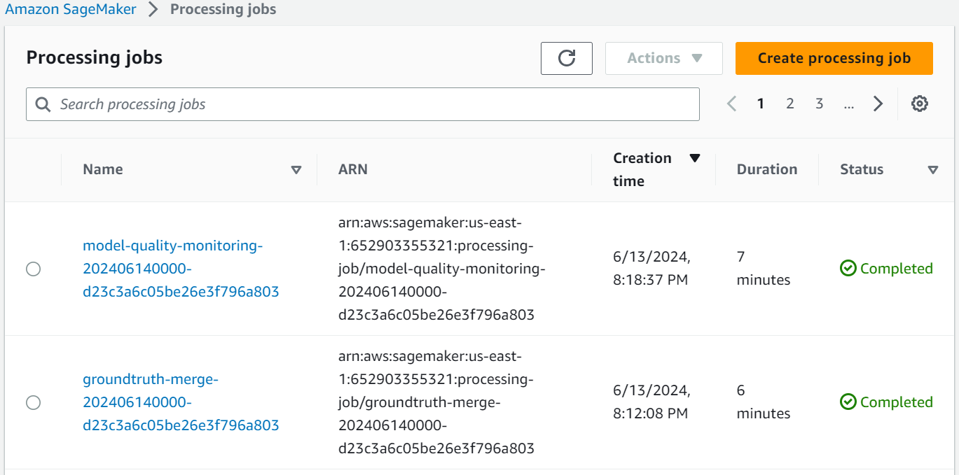
Model Quality Monitor (Setup)
Monitoring Job: Continuous quality monitoring to identify drift
Inputs:
Predictions from deployed model (captured via data capture on endpoint)
Ground truth data (generated synthetically)
Baseline (generated by Baseline job)
Notes:
Se’Lina

Slide 9
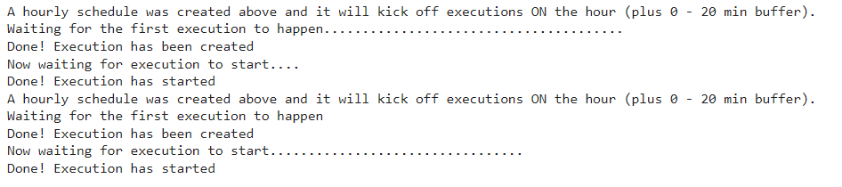
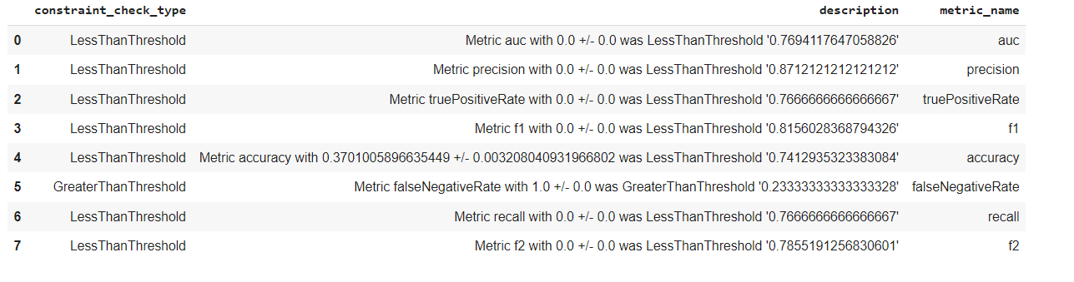
Model Quality Monitor (Setup)
Model Quality Monitoring Schedule
Schedule: Runs every hour
Threshold: Probability threshold set to 0.8
Output: Generates quality violations after each run
Notes:
Se’Lina

Slide 10
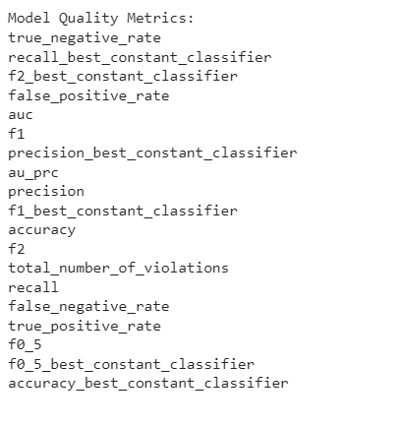
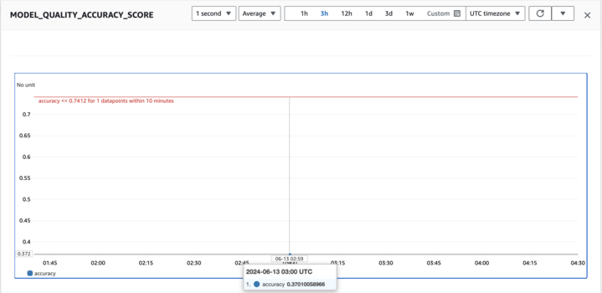
Model Quality Monitor (Alarm)
CloudWatch Alarm: Triggers when model quality drifts from baseline thresholds
Quality Threshold: Alarm activates if accuracy falls below 0.7412 (baseline constraint)
Notes:
Se’Lina

Slide 11
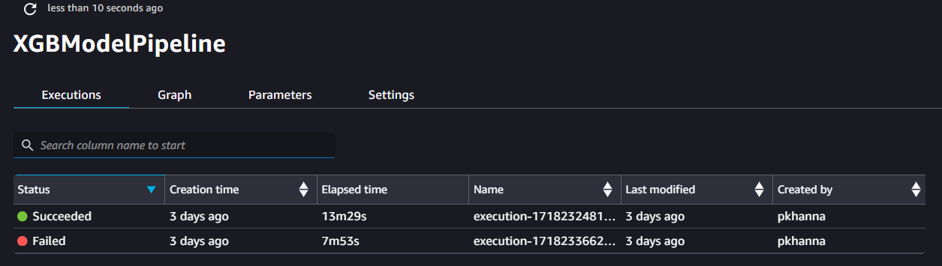
CI / CD DAG Overview
Orchestration and Reproducibility: Orchestrates SageMaker jobs; creates reproducible ML pipelines
Model Deployment: Deploys models for real-time and batch inference
Artifact Lineage Tracking: Tracks artifact lineage throughout the workflow
Operational Best Practices: Ensures sound practices for deploying and monitoring production workflows
SageMaker Pipeline Implementation:
Training Step
Evaluation Step
Condition Step
Fail Step
Create model
Register Model
Transform Step
Notes:
Se’Lina

Slide 12
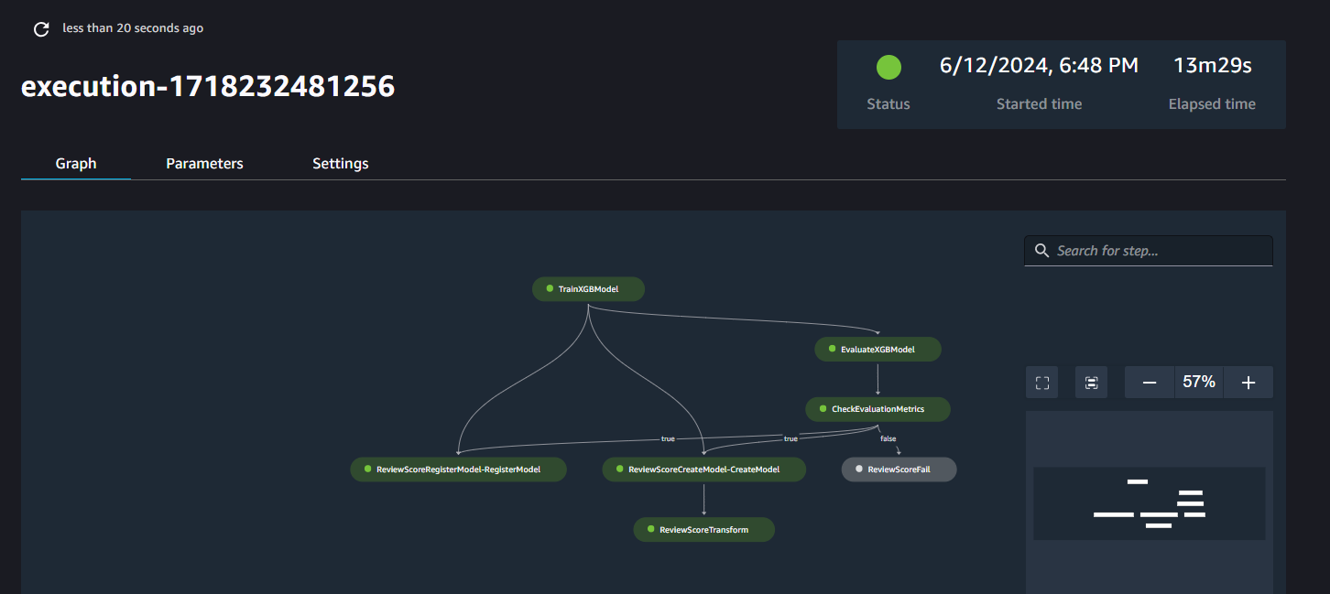
CI / CD DAG (Success)
Notes:
Se’Lina

Slide 13
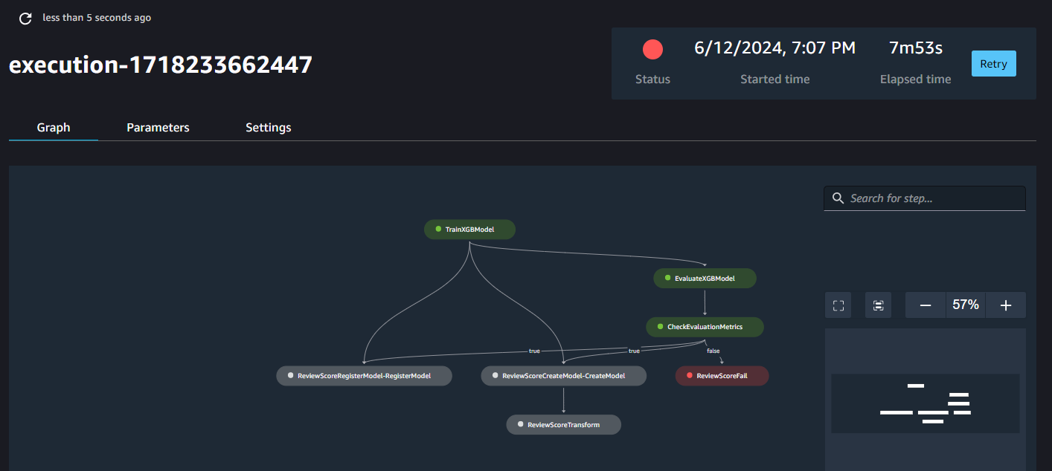
CI / CD DAG (Failure)
Notes:
Se’Lina

Slide 14
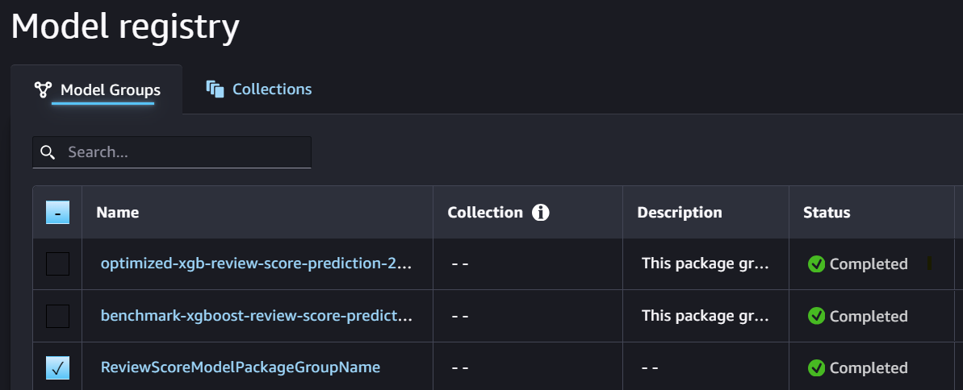
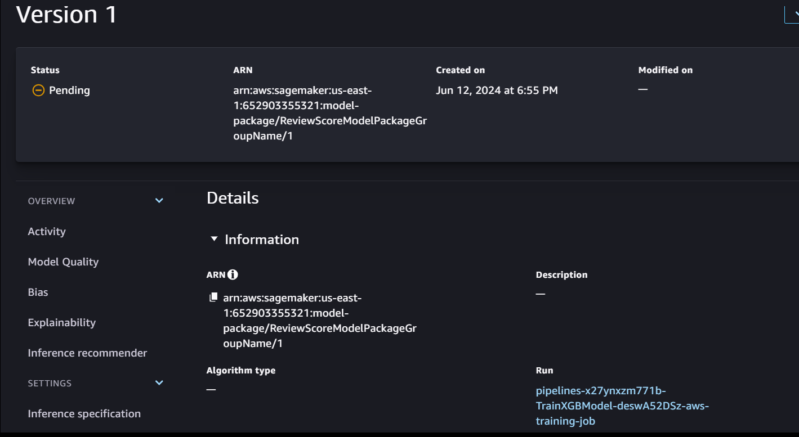
Model Upload/Registry
Model Package Group: Created for SageMaker pipeline
Model Registration: Models are registered in the Model Registry
Steps to Add Model:
Model Package: Includes model artifacts (inference specifications, model weights location, etc.)
Model Card: Includes model metadata (performance metrics, bias analysis, etc.)
Purpose: Enables tracking and management of model versions for reproducibility and governance
Notes:
Se’Lina

Slide 15
Future Improvements
Different Model
KNN Might be Better Suited
Different Features or other Engineered Features
More Focus on the Customers
Additional Monitors
Bias
Explanation
Resource
Notes:
Se’Lina

Slide 16
Thank You!
For Questions: pkhanna@sandiego.edu
slasher@sandiego.edu

